Slide 1
Engineering Drawing & Graphics
Lecture 01
ME-104 Engineering Drawing & Graphics
3T (3, 0)
By
Engr. M. Usman Khan
Engr.usman@uetpeshawar.edu.pk
03459230525

Slide 2

Communications
Class and e-groups often for announcements related to the course

Slide 3

Reading Assignments
Please make sure to read the assigned material for each week before the commencement of the corresponding week
Reading that material beforehand will help you greatly in absorbing with ease the matter discussed during the lecture

Slide 4




Marks Distribution
Assignments 15%
Quizzes 10%
Class Participation + -
Mid Term Paper 25 %
Final Term 50 %

Slide 5
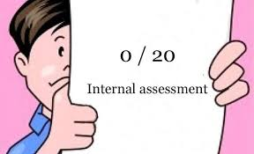
Assignments (15%)
Late homework policy: Late submission of assignments will result in “zero” marks
Assignments are to be submitted to CR before last date and he will submit them to me on Last date.
Done on an individual basis
Collaboration is fine, but it should be you alone who writes up the answers.

Slide 6
Quizzes (10%)
Quiz may be announced or may be surprise.

Slide 7

Mid term Exam
As per academic calendar
Duration: Two hours
Will cover all material covered during the first 8 weeks

Slide 8

Final Exam
As per academic calendar
Will cover the whole course before and after midterm
Duration: - two hours

Slide 9
Recommended Books
Elementary Engineering Drawing, ANY Edition by N. D. Bhatt.
First Year Engineering Drawing by A.C Parkinson.
Introduction to AutoCAD 2009 2D and 3D Design First edition Alf Yarwood
Illustrated AutoCAD by T. W. Berghauser and P. L. Sclive
Other latest books/online resources covering the course content.

Slide 10
Course Outline:
Manual Drawing:
Engineering drawing fundamentals, types of lines and usage, dimensioning, lettering, sheet planning, orthogonal projections, 1st angle projection, 3rd angle project, isometric view, Orthographic Projections
AutoCAD :
CAD/CAM tools, vector and raster data, using AutoCAD as 2D drafting tool, coordinate systems, drawing scale and viewing magnification, drawing primitives e.g. LINE, ARC, CIRCLE, TEXT, geometric transformations e.g. MOVE, COPY, SCALE, ARRAY, editing e.g. ERASE, TRIM, EXTEND, FILLET, CHAMFER, STRETCH, using snap and object snap facilities, creating and using symbols, layers, hatching, multiple line types and colors, dimensioning, paper view, sectional drawing and assembly drawing, printing and plotting drawings.

Slide 11
INTRODUCTIOIN TO ENGINEERING DRAWING:
A language to describe
Shape
Size
Fit
Assembly

Slide 12
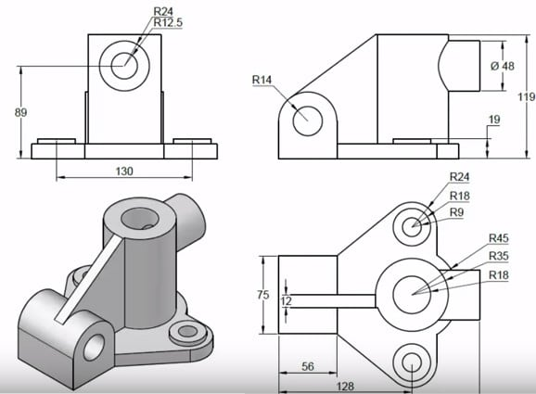
TYPES OF DRAWING:
Detail Drawings
To describe the shape, size, fit and finish of each and every part in detail for production purposes.

Slide 13
TYPES OF MEASURING SYSTEMS:
English
Feet and Inches
Metric
Meters and Millimeters

Slide 14
DRAWING INSTUMENTS AND THEIR USES:
Drawing Board
Serves as a flat drawing surface to attach a paper to.
Drafting Media
Paper
Film (Tracing Paper)
Standard Sizes are:
USA size, inches Closest International size, mm
A (8.5 x 11.0) A4 (210 x 297)
B (11.0 x 17.0) A3 (297 x 420)
C (17.0 x 22.0) A2 (420 x 594)
D (22.0 x 34.0) A1 (594 x 841)
E (34.0 x 44.0) A0 (841 x 1189)

Slide 15
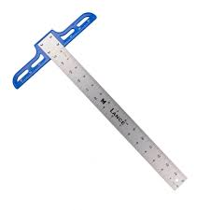
Pencils
Classification according to lead hardness is:
Hard grades Medium grades Soft grades
9H Hardest 3H Hardest 2B Hardest
8H 2H 3B
7H H 4B
6H F 5B
5H HB 6B
4H Softest B Softest 7B Softest
Eraser
T Square
For drawing horizontal lines and provide a supporting/sliding edge for set-squares and other stencils.

Slide 16
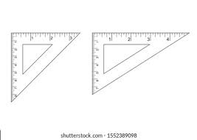
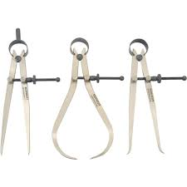
Set-Squares
For drawing vertical and angular lines
Scales
Linear scales (English and Metric)
Cardboard scales (For reducing and increasing size)
Diagonal scales (For measuring fractions)
Protractor (For measurement of angles)
Compass with Extender
For drawing circles and circular arcs
Divider
For transferring measurements and for dividing lines into any number of equal parts.

Slide 17
TYPES OF LINES USED IN ENGINEERING DRAWING:

Slide 21
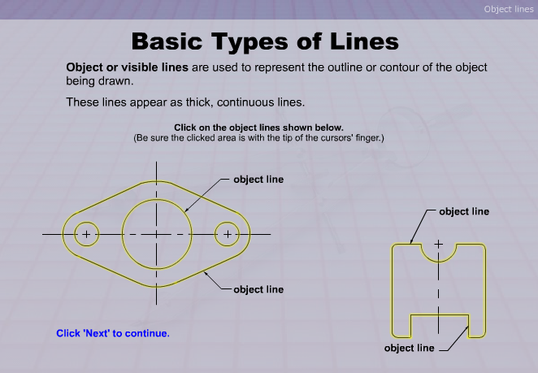

Slide 22
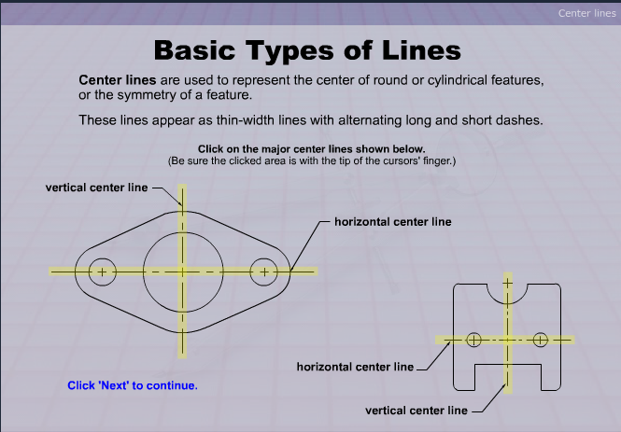

Slide 23
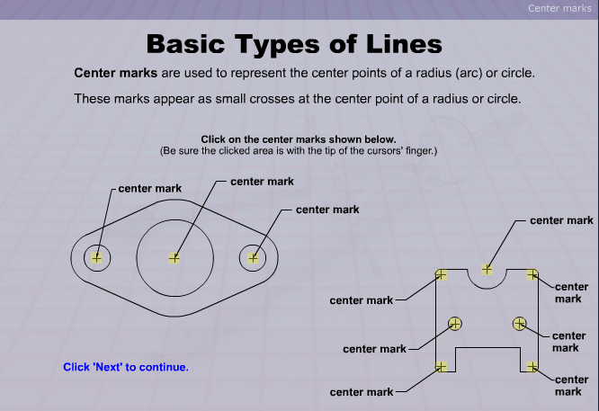

Slide 24
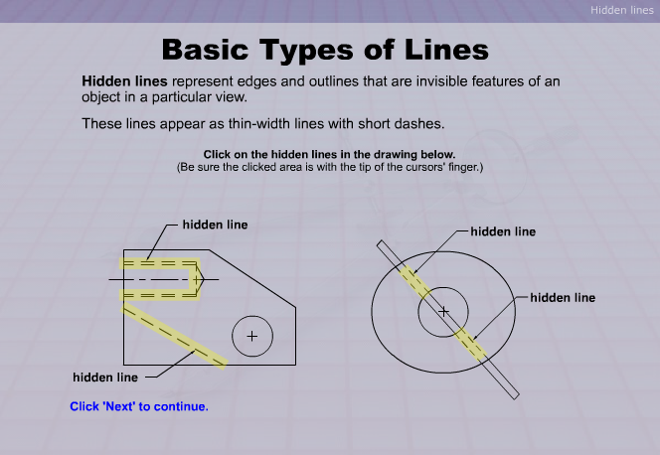

Slide 25
SCALES
SCALES
Reducing Scales
For objects drawn smaller than their actual size
Enlarging Scales
For objects drawn larger than their actual size

Slide 26
Representative Fraction (R.F.)
The ratio of the length of the drawing to the actual length of the object represented
Represented in the form of X : Y
X is the unit on the drawing whereas Y is the representation on the actual object.
A scale of 1:2 means 1 unit of length on the drawing representing 2 units of length of the object.
A scale of 2:1 means 2 units of length on the drawing representing 1 unit of length of the object.

Slide 27
TYPES OF SCALES
Metric Scales
Based on the decimal system
Reducing scales usually used are:
1:2, 1:2.5, 1:5, 1:10, 1:20, 1:25, 1:50, 1:100, 1:200, 1:250 etc.
Enlarging scales usually used are:
2:1, 2.5:1, 5:1, 10:1, 20:1, 25:1, 50:1, 100:1, 200:1, 250:1 etc.
Inch-Foot (English) Scales
Based on decimal and fraction system
Reducing and Enlarging scales have similar R.F. to Metric scales in the decimal system.
Fraction system has R.Fs of the type
1:2, 1:3, 1:4, 1:6, 1:12 etc. or vice versa.

Slide 28
INCH DIVISIONS
Fractions (8ths)

Slide 29
INCH DIVISIONS
Fractions (8ths)

Slide 30
INCH DIVISIONS
Fractions (8ths)

Slide 31
INCH DIVISIONS
Fractions (8ths)

Slide 32
INCH DIVISIONS
Fractions (8ths)

Slide 33
INCH DIVISIONS
Fractions (8ths)

Slide 34
Decimal (10ths)

Slide 35
Decimal (10ths)

Slide 36
Decimal (10ths)

